Slide 1
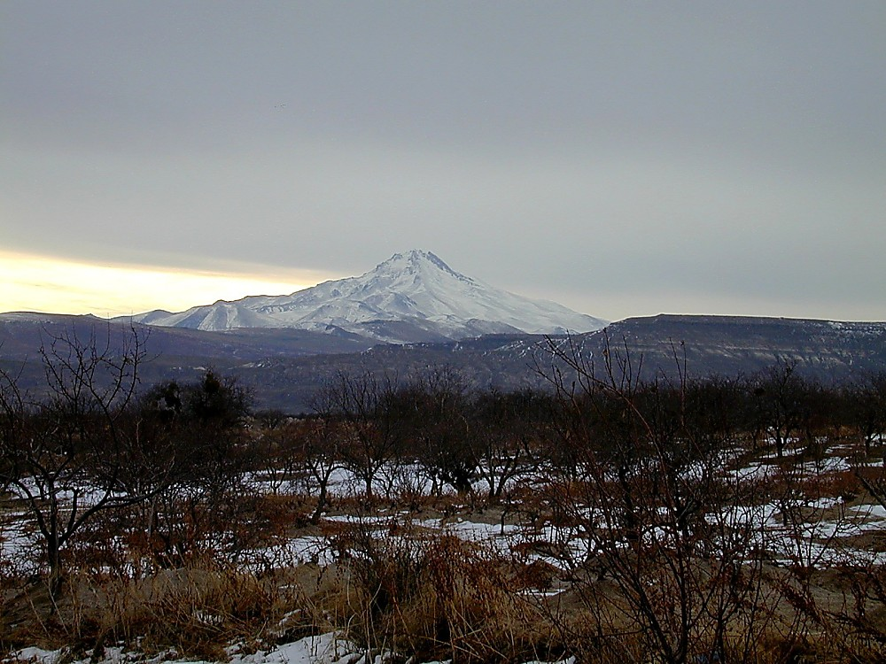
1 Peter 1.1-12
Experiencing hope and joy
despite suffering
Erciyas Dagi volcano in Cappadocia
This photo is from the collection "Pictorial Library of Bible Lands, volumes 1-10," © 2006 by Todd Bolen, BiblePlaces.com

Slide 2
¹Peter, an apostle of Jesus Christ, To God's elect, exiles scattered throughout the provinces of Pontus, Galatia, Cappadocia, Asia and Bithynia, ²who have been chosen according to the foreknowledge of God the Father, through the sanctifying work of the Spirit, to be obedient to Jesus Christ and sprinkled with his blood: Grace and peace be yours in abundance.

Slide 3
¹Peter, an apostle of Jesus Christ,
To God's elect, exiles scattered throughout the provinces of Pontus, Galatia, Cappadocia, Asia and Bithynia...

Slide 4
To God's elect... ² who have been chosen according to the foreknowledge of
God the Father, through the sanctifying work of the Spirit, to be obedient to
Jesus Christ and sprinkled with his blood...

Slide 5
Because God chose us,
because Christ died for us,
because the Holy Spirit set us apart,
we can know
– regardless of what is going on in our lives –
that God loves us and values us.

Slide 6
³Praise be to the God and Father of our Lord Jesus Christ! In his great mercy he has given us new birth into a living hope through the resurrection of Jesus Christ from the dead, ⁴and into an inheritance that can never perish, spoil or fade. This inheritance is kept in heaven for you, ⁵who through faith are shielded by God's power until the coming of the salvation that is ready to be revealed in the last time.

Slide 7
³Praise be to the God and Father of our Lord Jesus Christ! In his great mercy he has given us new birth into a living hope through the resurrection of Jesus Christ from the dead...

Slide 8
[God] has given us new birth into a
living hope... ⁴and into an inheritance that can never perish, spoil or fade.

Slide 9
This inheritance is kept in heaven for you, ⁵who through faith are shielded by God's power until the coming of the salvation that is ready to be revealed in the last time.

Slide 10
Justification [instant]: God accounts Christ’s righteousness to the believer
  Sanctification [process]: God purifies the believer to be more like Christ in character
    Glorification [at death]: God completes purification of the believer’s character
      Resurrection [when Christ returns]: God redeems the believer’s body

Slide 11
⁶In all this you greatly rejoice, though now for a little while you may have had to suffer grief in all kinds of trials. ⁷These have come so that the proven genuineness of your faith--of greater worth than gold, which perishes even though refined by fire--may result in praise, glory and honor when Jesus Christ is revealed.

Slide 12
⁸Though you have not seen him, you love him; and even though you do not see him now, you believe in him and are filled with an inexpressible and glorious joy, ⁹for you are receiving the end result of your faith, the salvation of your souls.

Slide 13
⁶In all this you greatly rejoice, though now for a little while you may have had to suffer grief in all kinds of trials. ⁷These have come so that the proven genuineness of your faith--of greater worth than gold, which perishes even though refined by fire--may result in praise, glory and honor when Jesus Christ is revealed.

Slide 14
⁶In all this you greatly rejoice, though now for a little while you may have had to suffer grief in all kinds of trials. ⁷These have come so that the proven genuineness of your faith--of greater worth than gold, which perishes even though refined by fire--may result in praise, glory and honor when Jesus Christ is revealed.

Slide 15
¹⁰Concerning this salvation, the prophets, who spoke of the grace that was to come to you, searched intently and with the greatest care, ¹¹trying to find out the time and circumstances to which the Spirit of Christ in them was pointing when he predicted the sufferings of the Messiah and the glories that would follow.

Slide 16
¹²It was revealed to them that they were not serving themselves but you, when they spoke of the things that have now been told you by those who have preached the gospel to you by the Holy Spirit sent from heaven. Even angels long to look into these things.

Slide 17
1. Expect to Suffer.
2. Trust always that God loves you.
3. Experience hope and joy even when suffering.
4. Understand how fortunate you are to have assurance.

Slide 18
1 Peter 1.1-12
Experiencing hope and joy
despite suffering
Erciyas Dagi volcano in Cappadocia
This photo is from the collection "Pictorial Library of Bible Lands, volumes 1-10," © 2006 by Todd Bolen, BiblePlaces.com

Slide 19
χάρις ὑμῖν καὶ εἰρήνη
CHA-ris hoo-MEEN KYE ay-RAY-nay
“grace to you and peace”
Grace and Peace to You!

